Slide 1
ADHOC & SENSOR NETWORKS
Dr. Md. Sazzadur Rahman
Associate Professor
Jahangirnagar University, Savar, Dhaka.

Slide 2
UNIT : WIRELESS SENSOR NETWORKS (WSNS) AND MAC PROTOCOLS
Single node architecture: hardware and software components of a sensor node –
WSN Network architecture: typical network architectures-data relaying and aggregation strategies –
MAC layer protocols: self-organizing, Hybrid TDMA/FDMA and CSMA based MAC- IEEE 802.15.4.

Slide 3
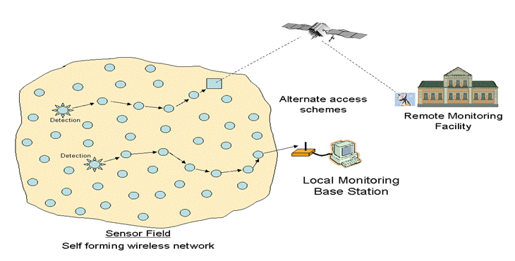
Introduction
Wireless Sensor Network?
It’s a collection of devices “ sensor nodes”
They are small, inexpensive, with constrained power
They are organized in a cooperative network
They communicate wirelessly
in multi hop routing
Heavily deployment
Changing network topology

Slide 4
Introduction
Component and Schematic of Node
Processor.
Memory.
RF Radio.
Power Source.
Sensor.
GPS
Power
Signal
Processor
Wireless Transmitter/ Receiver
Processing And Decision Making
Sensors
Control

Slide 5
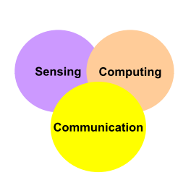
Introduction
Goal of Wireless Sensor Network
Collect data at regular intervals.
Then transform data into an electrical signal.
Finally, send the signals to the sink or the base nod.
Types of Wireless Sensor Network
Temperature sensor.
Light sensor.
Sound sensor.
Vibration Sensor.

Slide 6
Introduction
Communication pattern
Broadcast : Base station transmits message to all its immediate neighbors.
Converge cast : a group of sensors communicates to a specific sensor
Local gossip: a sensor node sends a message to its neighboring nodes within a range.

Slide 7
WSN Definition
A sensor network is composed of a large number of sensor nodes that are densely deployed inside or very close to the phenomenon
random deployment
self-organizing capabilities
Each node of the sensor networks consist of three subsystem:
Sensor subsystem: senses the environment
Processing subsystem: performs local computations on the sensed data
Communication subsystem: responsible for message exchange with neighboring sensor nodes
The features of sensor nodes
Limited sensing region, processing power, energy

Slide 8
WSN
The advantage of sensor networks
Robust : a large number of sensors
Reliable :
Accurate : sensor networks covering a wider region
Fault-tolerant : many nodes are sensing the same event
Two important operations in a sensor networks
Data dissemination : the propagation of data/queries throughout the network
Data gathering : the collection of observed data from the individual sensor nodes to a sink
The different types of sensors
Seismic, thermal, visual, infrared

Slide 9
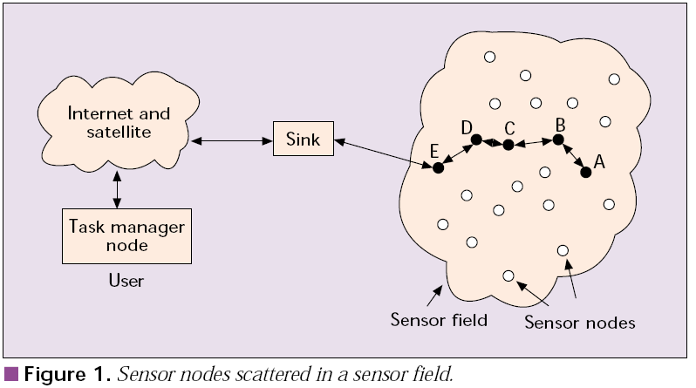
WSN Communication Architecture

Slide 10
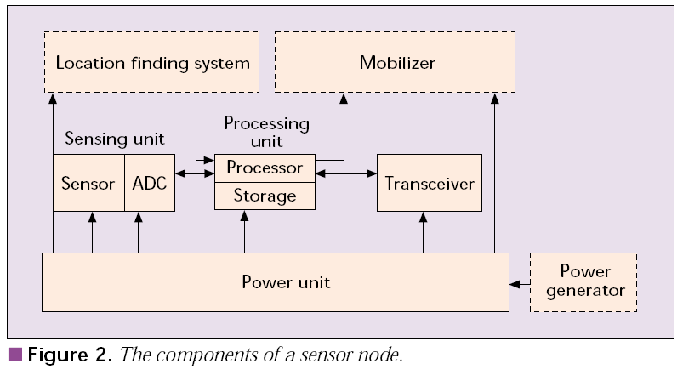
Components of Sensor Node

Slide 11
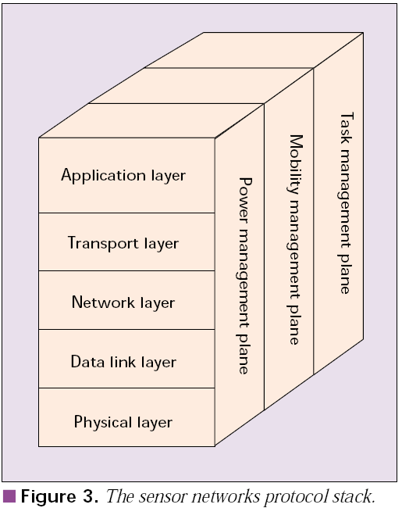
Protocol Stack
Protocols should be
Power aware
Location aware
Application aware

Slide 12
WSN Characteristics
Major differences between sensor and ad-hoc network
Number of nodes is higher
Densely deployment
Sensor nodes are prone to failure.
Frequent topology changes
Broadcast communication paradigm
Limited processing and power capabilities.
Possible absence of unique global ID

Slide 13
WSN Design Factors
Fault Tolerance
Scalability
Production Costs
Hardware Constraints
Sensor Network Topology
Environment
Transmission Media
Power Consumption

Slide 14
Design Factors : Fault Tolerance
Each Nodes are prone to unexpected failure (more than other network)
Fault tolerance is the ability to sustain sensor network functionalities without any interruption due to sensor node failures.

Slide 15
Design Factors : Scalability
Size: Number of node (100 ~1000)
Density : μ(R)=(NR²)/A
Protocol should
be able to scale to such high degree
take advantage of the high density of such networks

Slide 16
Design Factors: Production Costs
The cost of a single node must be low given the amount of functionalities
Much less than $1

Slide 17
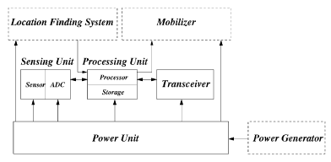
Design Factors:Hardware Constraint
All these units combined together must
Extremely low power
Extremely small volume

Slide 18
Design Factors : Topology
Must be maintained specially in very high densities
Pre-deployment and deployment phase
Post-deployment phase
Re-deployment of additional nodes phase

Slide 19
Design Factors : Environment
May be inaccessible
either because of hostile environment
or because they are embedded in a structure
Impact of environment condition
Temperature
Humidity
Movement
Underwater
Underground

Slide 20
Design Factors: Environment
Busy intersections
Interior of a large machinery
Bottom of an ocean
Surface of an ocean during a tornado
Biologically or chemically contaminated field
Battlefield beyond the enemy lines
Home or a large building
Large warehouse
Animals
Fast moving vehicles
Drain or river moving with current

Slide 21
Design Factors : Transmission Media
RF
Infrared
Optical
Acoustic

Slide 22
Design Factors: Power Consumption
Power conservation
Sensing
Communication
Data processing

Slide 23
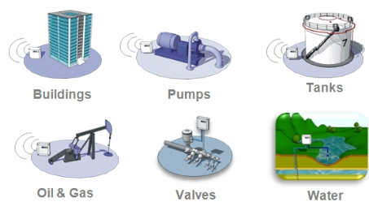
Applications of WSN
Global scale
Battle field
Factories
Buildings
Homes
bodies

Slide 24
Applications of Sensor Networks
Using in military
Battlefield surveillance and monitoring, guidance systems of intelligent missiles, detection of attack by weapons of mass destruction such as chemical, biological, or nuclear
Using in nature
Forest fire, flood detection, habitat exploration of animals
Using in health
Monitor the patient’s heart rate or blood pressure, and sent regularly to alert the concerned doctor, provide patients a greater freedom of movement

Slide 25
Applications of Sensor Networks
Using in home (smart home)
Sensor node can built into appliances at home, such as ovens, refrigerators, and vacuum cleaners, which enable them to interact with each other and be remote-controlled
Using in office building
Airflow and temperature of different parts of the building can be automatically controlled
Using in warehouse
Improve their inventory control system by installing sensors on the products to track their movement

Slide 26
Comparison with Ad Hoc Wireless Networks
Different from Ad Hoc wireless networks
The number of nodes in sensor network can be several orders of magnitude large than the number of nodes in an ad hoc network.
Sensor nodes are more easy to failure and energy drain, and their battery sources are usually not replaceable or rechargeable.
Sensor nodes may not have unique global identifiers (ID), so unique addressing is not always feasible in sensor networks.
Sensor networks are data-centric, the queries in sensor networks are addressed to nodes which have data satisfying some conditions. Ad Hoc networks are address-centric, with queries addressed to particular nodes specified by their unique address.
Data fusion/aggregation: the sensor nodes aggregate the local information before relaying. The goals are reduce bandwidth consumption, media access delay, and power consumption for communication.

Slide 27
Issues and Challenges
Sensor nodes are randomly deployed and hence do not fit into any regular topology. Once deployed, they usually do not require any human intervention. Hence, the setup and maintenance of the network should be entirely autonomous.
Sensor networks are infrastructure-less. Therefore, all routing and maintenance algorithms need to be distributed.
Energy problem
Hardware and software should be designed to conserve power
Sensor nodes should be able to synchronize with each other in a completely distributed manner, so that TDMA schedules can be imposed.
A sensor network should also be capable of adapting to changing connectivity due to the failure of nodes, or new nodes powering up. The routing protocols should be able to dynamically include or avoid sensor nodes in their paths.
Real-time communication over sensor networks must be supported through provision of guarantees on maximum delay, minimum bandwidth, or other QoS parameters.
Provision must be made for secure communication over sensor networks, especially for military applications which carry sensitive data.

Slide 28
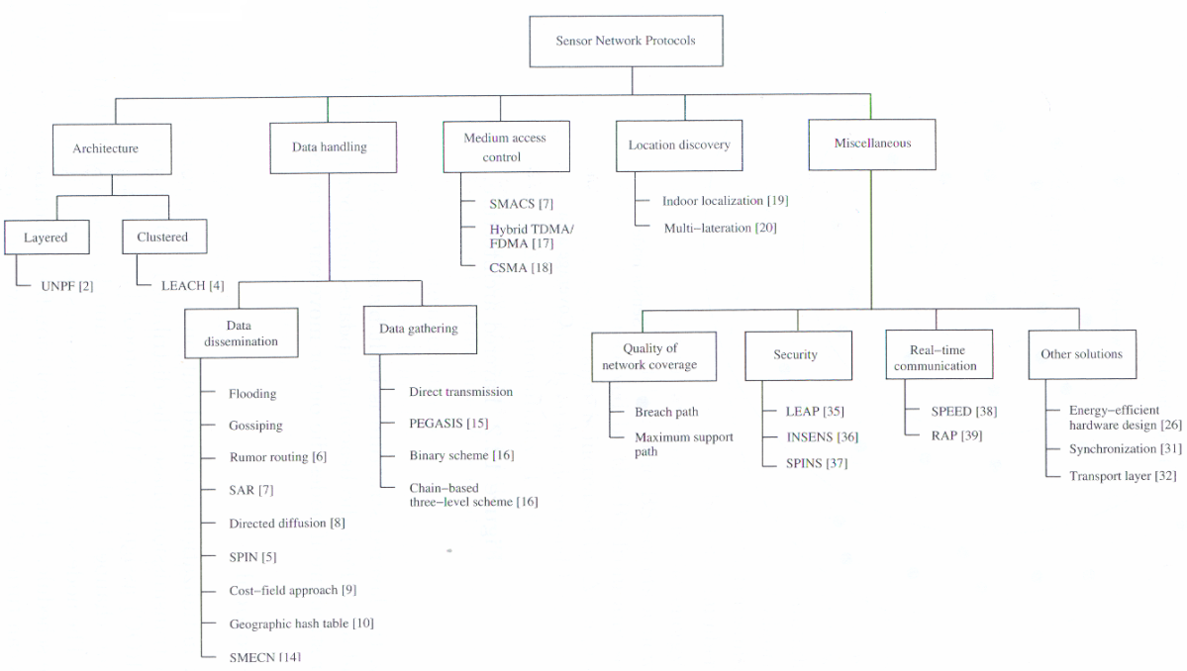
Classification of sensor network protocol

Slide 29
Sensor Network Architecture
The two basic kinds of sensor network architecture
Layered Architecture
Clustered Architecture

Slide 30
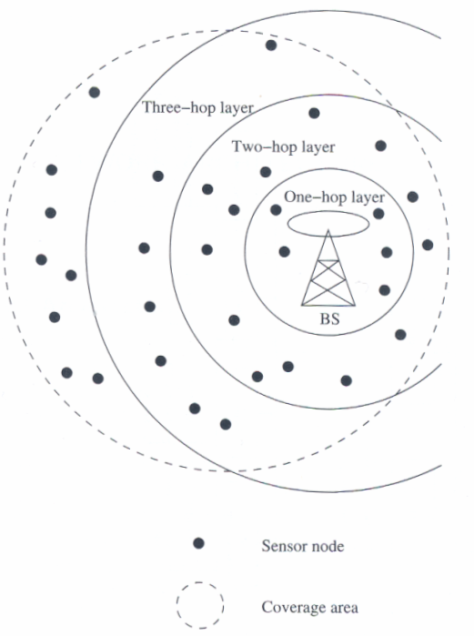
Layered Architecture
A layered architecture has a single powerful base station, and the layers of sensor nodes around it correspond to the nodes that have the same hop-count to the BS.
In the in-building scenario, the BS acts an access point to a wired network, and small nodes form a wireless backbone to provide wireless connectivity.
The advantage of a layered architecture is that each node is involved only in short-distance, low-power transmissions to nodes of the neighboring layers.

Slide 31
Unified Network Protocol Framework (UNPF)
UNPF is a set of protocols for complete implementation of a layered architecture for sensor networks
UNPF integrates three operations in its protocol structure:
Network initialization and maintenance
MAC protocol
Routing protocol

Slide 32
Network initialization and maintenance
The BS broadcasts its ID using a known CDMA code on the common control channel.
All node which hear this broadcast then record the BS ID. They send a beacon signal with their own IDs at their low default power levels.
Those nodes which the BS can hear form layer one
BS broadcasts a control packet with all layer one node IDs. All nodes send a beacon signal again.
The layer one nodes record the IDs which they hear (form layer two) and inform the BS of the layer two nodes IDs.
Periodic beaconing updates neighbor information and change the layer structure if nodes die out or move out of range.

Slide 33
MAC protocol
During the data transmission phase, the distributed TDMA receiver oriented channel (DTROC) assignment MAC protocol is used.
Two steps of DTROC
Channel allocation : Each node is assigned a reception channel by the BS, and channel reuse is such that collisions are avoided.
Channel scheduling : The node schedules transmission slots for all its neighbors and broadcasts the schedule. This enables collision-free transmission and saves energy, as nodes can turn off when they are not involved on a send/receive operation.

Slide 34
Routing protocol
Downlink from the BS is by direct broadcast on the control channel. Uplink from the sensor nodes to BS is by multi-hop data forwarding.
The node to which a packet is to be forwarded is selected considering the remaining energy of the nodes. This achieves a higher network lifetime.

Slide 35
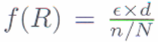
UNPF-R
Optimize the network performance by make the sensor nodes adaptively vary their transmission range.
Because while a very small transmission range cause network partitioning, a very large transmission range reduce the spatial reuse of frequencies.
The optimal range (R) is determined by simulated annealing
Objective function :
N : the total number of sensors
n : the number of nodes in layer one
: the energy consumption per packet
d : the average packet delay

Slide 36
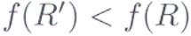
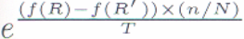

UNPF-R
If no packet is received by the BS from any sensor node for some interval of time, the transmission range increase by . Otherwise, the transmission range is either decrease by with probability 0.5 x ( n / N ), or increase by with probability [ 1 – 0.5 x ( n / N ) ].
If , then the transmission range R’ is adopt. Otherwise, R is modified to R’ with probability
T : the temperature parameter
The advantage of the UNPF-R :
Minimize the energy x delay
Maximize the number of nodes which can connect to the BS

Slide 37
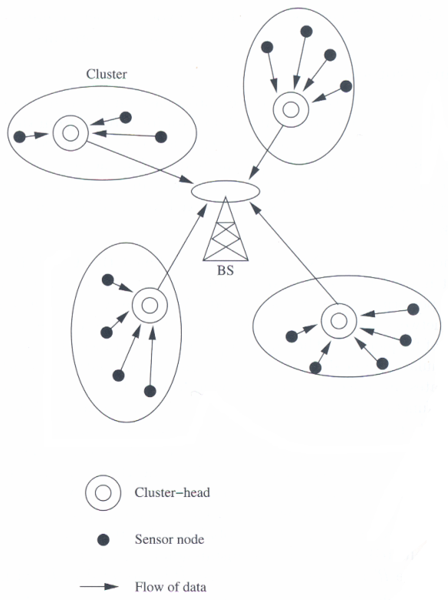
Clustered Architecture
A clustered architecture organizes the sensor nodes into clusters, each governed by a cluster-head. The nodes in each cluster are involved in message exchanges with their cluster-heads, and these heads send message to a BS.
Clustered architecture is useful for sensor networks because of its inherent suitability for data fusion. The data gathered by all member of the cluster can be fused at the cluster-head, and only the resulting information needs to be communicated to the BS.
The cluster formation and election of cluster-heads must be an autonomous, distributed process.

Slide 38
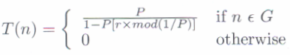
Low-Energy Adaptive Clustering Hierarchy (LEACH)
LEACH is a clustering-based protocol that minimizes energy dissipation in sensor networks. The operation of LEACH is spilt into two phases : setup and steady.
Setup phase : each sensor node chooses a random number between 0 and 1. If this is lower than the threshold for node n, T(n), the sensor node becomes a cluster-head. The threshold T(n) is calculated as
P : the percentage of nodes which are cluster-heads
r : the current round
G : the set of nodes that has not been cluster-heads in the past 1/P rounds

Slide 39
Low-Energy Adaptive Clustering Hierarchy (LEACH)
After selection, the cluster-heads advertise their selection to all nodes. All nodes choose their nearest cluster-head by signal strength (RSSI). The cluster-heads then assign a TDMA schedule for their cluster members
Steady phase : data transmission takes place based on the TDMA schedule, and the cluster-heads perform data aggregation/fusion.
After a certain period of time in the steady phase, cluster-heads are selected again through the setup phase.

Slide 40
Data Dissemination
Data dissemination is the process by which queries or data are routed in the sensor network. The data collected by sensor nodes has to be communicated to the node which interested in the data.
The node that generates data is call source and the information to be reported is called an event. A node which interested in an event is called sink.
Data dissemination consist of a two-step process : interest propagation and data propagation.
Interest propagation : for every event that a sink is interested in, it broadcasts its interest to is neighbor, and across the network.
Data dissemination : When an event is detected, it reported to the interested nodes (sink).

Slide 41
Flooding
Each node which receives a packet (queries/data) broadcasts it if the maximum hop-count of the packet is not reached and the node itself is not the destination of the packet.
Disadvantages :
Implosion : this is the situation when duplicate messages are send to the same node. This occurs when a node receives copies of the same messages from many of its neighbors.
Overlap : the same event may be sensed by more than one node due to overlapping regions of coverage. This results in their neighbors receiving duplicate reports of the same event.
Resource blindness : the flooding protocol does not consider the available energy at the nodes and results in many redundant transmissions. Hence, it reduces the network lifetime.

Slide 42
Gossiping
Modified version of flooding
The nodes do not broadcast a packet, but send it to a randomly selected neighbor.
Avoid the problem of implosion
It takes a long time for message to propagate throughout the network.
It does not guarantee that all nodes of network will receive the message.

Slide 43
Rumor Routing
Agent-based path creation algorithm
Agent is a long-lived packet created at random by nodes, and it will die after visit k hops.
It circulated in the network to establish shortest paths to events that they encounter.
When an agent finds a node whose path to an event is longer than its own, it updates the node’s routing table.

Slide 44
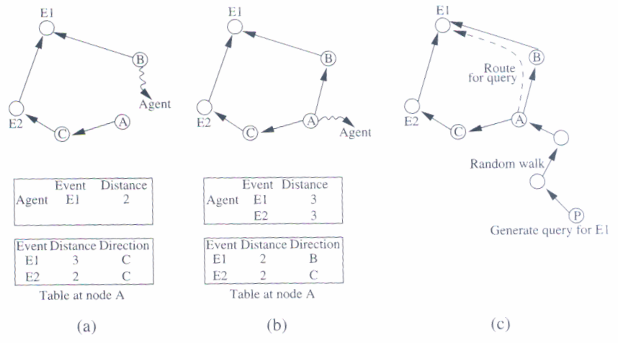
Rumor routing
After selection, the cluster-heads advertise their selection to all nodes. All nodes choose their nearest cluster-head by signal strength (RSSI). The cluster-heads then assign a TDMA schedule for their cluster members

Slide 45
Sequential Assignment Routing (SAR)
The sequential assignment routing (SAR) algorithm creates multiple trees, where the root of each tree is a one-hop neighbor of the sink.
To avoid nodes with low throughput or high delay.
Each sensor node records two parameters about each path though it : available energy resources on the path and an additive QoS metric such as delay.
Higher priority packets take lower delay paths, and lower priority packets have to use the paths of greater delay, so that the priority x delay QoS metric is maintained.
SAR minimizes the average weighted QoS metric over the lifetime of the network.

Slide 46
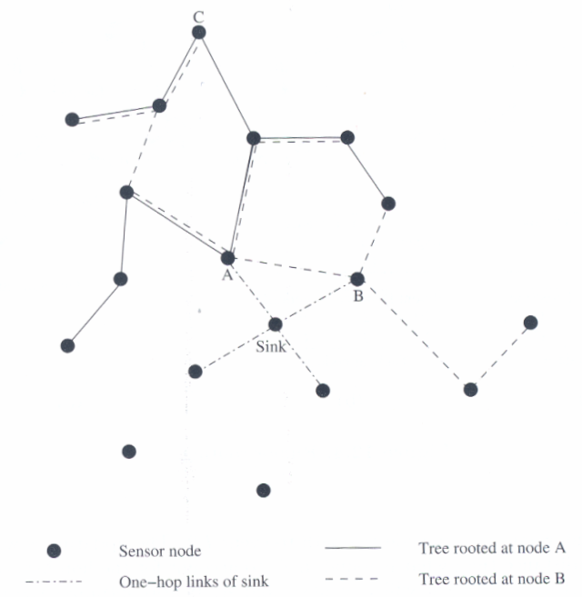
Sequential Assignment Routing (SAR)

Slide 47
Directed Diffusion
The directed diffusion protocol is useful in scenarios where the sensor nodes themselves generate requests/queries for data sensed by other nodes.
Each sensor node names its data with one or more attributes.
Each sensor node express their interest depending on these attributes.
Each path is associated with a interest gradient, while positive gradient make the data flow along the path, negative gradient inhibit the distribution data along a particular path.
Example : two path formed with gradient 0.4 and 0.8, the source may twice as much data along the higher one
Suppose the sink wants more frequent update from the sensor which have detected an event => send a higher data-rate requirement for increasing the gradient of that path.

Slide 48
Directed Diffusion
Query
Type = vehicle /* detect vehicle location
interval = 1 s /* report every 1 second
rect = [0,0,600,800] /* query addressed to sensors within the rectangle
timestamp = 02:30:00 /* when the interest was originated
expiresAt = 03:00:00 /* till when the sink retain interest in this data
Report
Type = vehicle /* type of intrusion seen
instance = car /* particular instance of the type
location = [200,250] /* location of node
confidence = 0.80 /* confidence of match
timestamp = 02:45:20 /* time of detection

Slide 49
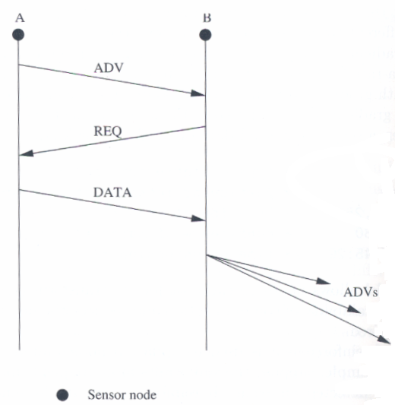
Sensor Protocols for Information via Negotiation
SPIN use negotiation and resource adaptation to address the disadvantage of flooding.
Reduce overlap and implosion, and prolong network lifetime.
Use meta-data instead of raw data.
SPIN has three types of messages:ADV, REQ, and DATA.
SPIN-2 using an energy threshold to reduce participation. A node may join in the ADV-REQ-DATA handshake only if it has sufficient resource above a threshold.

Slide 50
Cost-Field Approach
The cost-field approach considers the problem of setting up paths to a sink. The first phase being to set up the cost field, based on metrics such as delay. The second phase being data dissemination using the costs.
A sink broadcasts an ADV packet with its own cost as 0.
When a node N hears an ADV message from node M, it sets its own path cost to min (L_{N},L_{M}+C_{NM}), where L_{N} is the total path cost from node N to the sink, L_{M} is the cost of node M to the sink, C_{NM} is the cost from N to M.
If L_{N} updated, the new cost is broadcast though another ADV.
The back-off time make a node defer its ADV instead of immediately broadcast it. The back-off time is r x C_{MN}, where r is a parameter of algorithm.

Slide 51
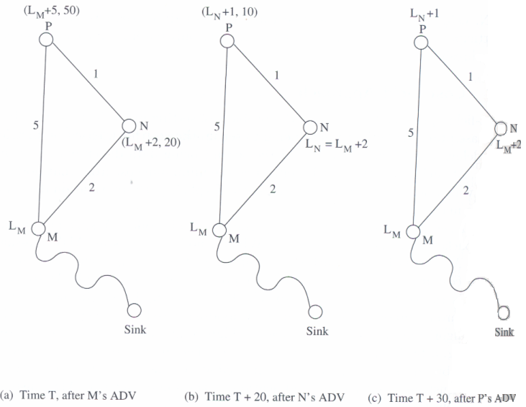
Cost-Field Approach

Slide 52
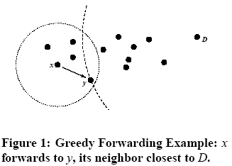
Geographic Hash Table (GHT)
GHT hashes keys into geographic coordinates and stores a (key, value) pair at the sensor node nearest to the hash value.
Stored data is replicated to ensure redundancy in case of node failures.
The data is distributed among nodes such that it is scalable and the storage load is balanced.
The routing protocol used is greedy perimeter stateless routing (GPSR), which again uses geographic information to route the data and queries.

Slide 53
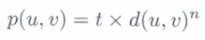
Small Minimum Energy Communication Network
If the entire sensor network is represented by G, the subgraph G’ is constructed such that the energy usage of the network is minimized.
The number of edges in G’ is less than G, and the connectivity between any two nodes is not disrupted by G’.
The power required to transmit data between u and v is modeled as
t : constant
n : loss exponent indicating the loss of power with distance from transmitter
d(u,v) : the distance between u and v
It would be more economical to transmit data by smaller hops

Slide 54
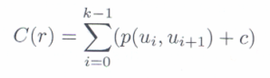
Small Minimum Energy Communication Network
Suppose the path between u (i.e. u₀) and v (i.e. u_{k}) is represented by r = (u₀, u₁, … u_{k}), each (u_{i}, u_{i+1}) is edge in G’
The total power consumed for the transmission is
C : the power needed to receive the data
The path r is the minimum energy path if C(r) ≦ C(r’) for all path’s r’ between u and v in G.
SMECN uses only the ME paths from G’ for data transmission, so that the overall energy consumed is minimized.

Slide 55
Data Gathering
The objective of the data gathering problem is to transmit the sensed data from each sensor node to a BS.
The goal of algorithm which implement data gathering is
maximize the lifetime of network
Minimum energy should be consumed
The transmission occur with minimum delay
The energy x delay metric is used to compare algorithm

Slide 56
Direct Transmission
All sensor nodes transmit their data directly to the BS.
It cost expensive when the sensor nodes are very far from the BS.
Nodes must take turns while transmitting to the BS to avoid collision, so the media access delay is also large. Hence, this scheme performs poorly with respect to the energy x delay metric.

Slide 57
Power-Efficient Gathering for Sensor Information Systems
PEGASIS based on the assumption that all sensor nodes know the location of every other node.
Any node has the required transmission range to reach the BS in one hop, when it is selected as a leader.
The goal of PEGASIS are as following
Minimize the distance over which each node transmit
Minimize the broadcasting overhead
Minimize the number of messages that need to be sent to the BS
Distribute the energy consumption equally across all nodes
To construct a chain of sensor nodes, starting from the node farthest from the BS. At each step, the nearest neighbor which has not been visited is added to the chain.
It is reconstructed when nodes die out.

Slide 58
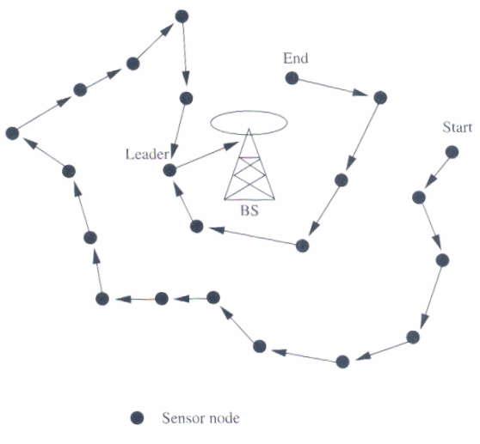
PEGASIS
At every node, data fusion or aggregation is carried out.
A node which is designated as the leader finally transmits one message to the BS.
Leadership is transferred in sequential order.
The delay involved in messages reaching the BS is O(N)

Slide 59
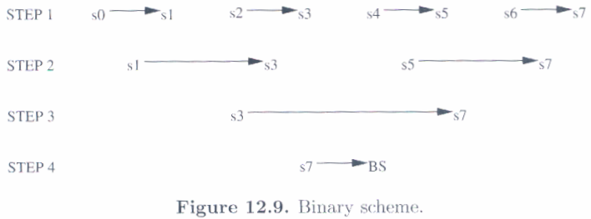
Binary Scheme
This is a chain-based scheme like PEGASIS, which classifies nodes into different levels.
This scheme is possible when nodes communicate using CDMA, so that transmissions of each level can take place simultaneously.
The delay is O(logN)

Slide 60
Chain-Based Three-Level Scheme
For non-CDMA sensor nodes
The chain is divided into a number of groups to space out simultaneous transmissions in order to minimize interference.
Within a group, nodes transmit data to the group leader, and the leader fusion the data, and become the member to the next level.
In the second level, all nodes are divided into two groups.
In the third level, consists of a message exchange between one node from each group of the second level.
Finally, the leader transmit a single message to the BS.

Slide 61
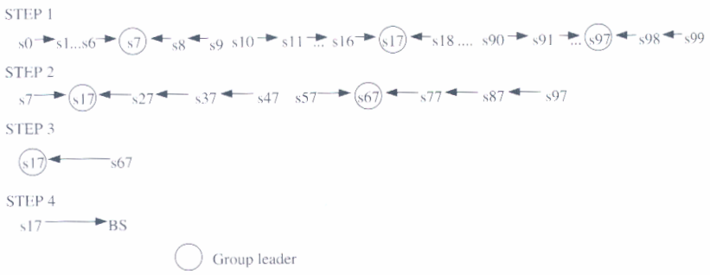
Chain-Based Three-Level Scheme

Slide 62
MAC Protocols for Sensor Networks
The challenges posed by sensor network MAC protocol
No single controlling authority, so global synchronization is difficult
Power efficiency issue
Frequent topology changes due to mobility and failure
There are three kinds of MAC protocols used in sensor network:
Fixed-allocation
Demand-based
Contention-based

Slide 63
MAC Protocols for Sensor Networks
Fixed-allocation MAC protocol
Share the common medium through a predetermined assignment.
It is suitable for sensor network that continuously monitor and generate deterministic data traffic
Provide a bounded delay for each node
However, in the case of bursty traffic, where the channel requirements of each node may vary over time, it may lead to inefficient usage of the channel.

Slide 64
MAC Protocols for Sensor Networks
Demand-based MAC protocol
Used in such cases, where the channel is allocated according to the demand of the node
Variable rate traffic can be efficiently transmitted
Require the additional overhead of a reservation process
Contention-based MAC protocol
Random-access-based contention for the channel when packets need to be transmitted
Suitable for bursty traffic
Collisions and no delay guarantees, are not suitable for delay-sensitive or real-time traffic

Slide 65
Self-Organizing MAC for Sensor Networks and Eavesdrop and Register
Self-Organizing MAC for sensor (SMACS) networks and eavesdrop and register (EAR) are two protocols which handle network initialization and mobility support, respectively.
In SMACS
neighbor discovery and channel assignment take place simultaneously in a completely distributed manner.
A communication link between two nodes consists of a pair of time slots, at fixed frequency.
This scheme requires synchronization only between communicating neighbors, in order to define the slots to be used for their communication.
Power is conserved by turning off the transceiver during idle slots.

Slide 66
Self-Organizing MAC for Sensor Networks and Eavesdrop and Register
In EAR protocol
Enable seamless connection of nodes under mobile and stationary conditions.
This protocol make use of certain mobile nodes, besides the existing stationary sensor nodes, to offer service to maintain connections.
Mobile nodes eavesdrop on the control signals and maintain neighbor information.

Slide 67
Hybrid TDMA/FDMA
A pure TDMA scheme minimize the time for which a node has to be kept on, but the associated time synchronization cost are very high.
A pure FDMA scheme allots the minimum required bandwidth for each connection
If the transmitter consumes more power, a TDMA scheme is favored, since it can be switch off in idle slots to save power.
If the receiver consumes greater power, a FDMA scheme is favored, because the receiver need not expend power for time synchronization.

Slide 68
CSMA-Base MAC Protocols
CSMA-based schemes are suitable for point-to-point randomly distributed traffic flows.
The sensing periods of CSMA are constant for energy efficiency, while the back-off is random to avoid repeated collisions.
Binary exponential back-off is used to maintain fairness in the network.
Use an adaptive transmission rate control (ARC) to balance originating traffic and route-through traffic in nodes. This ensures that nodes closer to the BS are not favored over farther nodes.
CSMA-based MAC protocol are contention-based and are designed mainly to increase energy efficiency and maintain fairness.

Slide 69
IEEE 802.15.4 MAC
Architecture
Channel acquisition
Contention Window
Applications
ZigBee Network
IEEE 802.15.4 MAC
IEEE 802.15.4
PHY
69

Slide 70
IEEE 802.15.4 MAC
Architecture
Device join and leave
Frame routing
Applications
ZigBee Network
IEEE 802.15.4 MAC
IEEE 802.15.4
PHY
70
Notes:
ZigBee的網路層負責設備加入和離開網路、訊框安全和訊框路由。另外網路層還負責路由發現和維護、發現一步內鄰居並儲存鄰居相關資訊。有需要存取媒介時，會告知下層的媒介存取層做處理。

Slide 71
IEEE 802.15.4
IEEE 802.15.4 task group began to develop a standard for LR-WPAN.
The goal of this group was to provide a standard with ultra-low complexity, cost, and power for low-data-rate wireless connectivity among inexpensive fixed, portable, and moving devices.
Notes:
Very low cost is needed because deployed applications are envisioned to be composed of possibly numerous, inexpensive, and disposable devices.

Slide 72
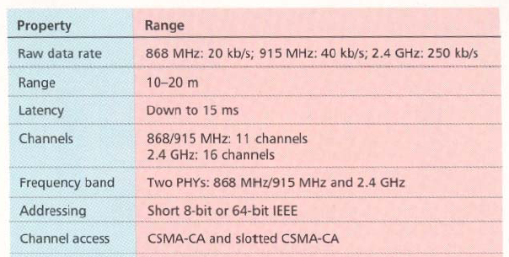
General characteristics

Slide 73
Approaches for low power
In order to achieve the low power and low cost goals established by IEEE 802.15.4 the following approaches are taken
Reduce the amount of data transmitted
Reduce the transceiver duty cycle and frequency of data transmissions
Reduce the frame overhead
Reduce complexity
Reduce range
Implement strict power management mechanisms (power-down and sleep modes)

Slide 74
IEEE 802.15.4 introduction
IEEE 802.15.4 deals with only PHY layer and portion of Data link layer.
The higher-layer protocols are left to industry and the individual applications.
The Zigbee Alliance is an association of companies involved with building higher-layer standards based on IEEE 802.15.4. This includes network, security, and application protocols.

Slide 75
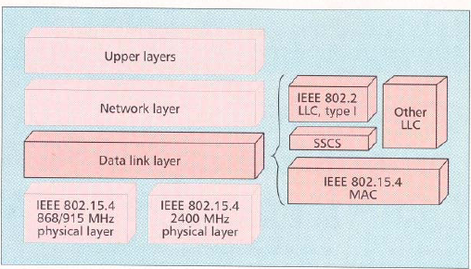
IEEE 802.15.4 in ISO-OSI layered network model

Slide 76
Network layer
The services which network layer provides are more challenging to implement because of low power consumption requirement.
Network layer over this standard are expected to be self configuring and self maintaining to minimize total cost of user.
IEEE 802.15.4 draft standard supports multiple network topologies including star and peer to peer topology.
topology selection is application dependent. PC peripherals may require low latency connection of star topology while perimeter security which needs large coverage area may require peer to peer networking.

Slide 77
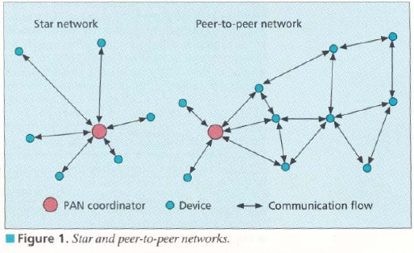
Star and Peer to Peer topologies

Slide 78
Data link layer
IEEE 802 splits DLL into MAC and LLC sublayers.
LLC is standardized and is common in 802.3,802.11,802.15.1.
features of the IEEE 802.15.4 MAC are association and disassociation, acknowledged frame delivery, channel access mechanism, frame validation, guaranteed time slot management, and beacon management.

Slide 79
MAC
MAC provides data and management services to upper layers
The MAC management service has 26 primitives whereas 802.15.1 has about 131 primitives and 32 events,
802.15.4 MAC is of very low complexity, making it very suitable for its intended low-end applications, albeit at the cost of a smaller feature set than 802.15.1 (e.g., 802.15.4 does not support synchronous voice links).

Slide 80
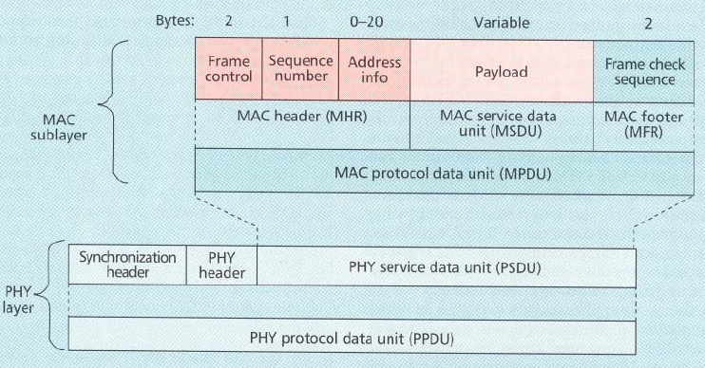
MAC frame format

Slide 81
MAC frame
Frame control field indicates the type of MAC frame being transmitted, specifies the format of the address field, and controls the acknowledgment.
Multiple address types : 64 bit physical address and short 16 bit network assigned address are provided.
Address field size may vary from 0 to 20 bytes.
Payload field is variable with condition size of mac frame <= 127 bytes.
FCS is used for integrity check using 16 bit CRC.

Slide 82
Superframe
Certain applications require dedicated bandwidth to achieve low latency for this it can operate in optional superframe mode
PAN coordinator, transmits superframe beacons in predetermined intervals which is divided into 16 time slots
The channel access in the time slots is contention-based but PAN coordinator may assign time slots to a single device requiring dedicated bandwidth or low-latency transmissions. These assigned time slots are called guaranteed time slots (GTS) and together form a contention-free period.

Slide 83
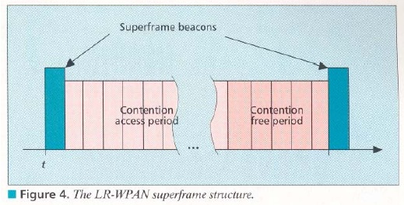
Superframe structure

Slide 84
Other MAC features
In a beacon-enabled network with superframes, a slotted carrier sense multiple access with collision avoidance (CSMA-CA) mechanism is used.
In others standard CSMA-CA is used I.e it first checks if another device is transmitting in the same channel if so backs off for certain time.
MAC confirms successful reception of data with an acknowledgement.
The IEEE 802.15.4 draft standard provides for three levels of security: no security of any type ,access control lists (non cryptographic security) and symmetric key security, employing AES-128.

Slide 85
PHY layer
This standard provides 2 PHY options with frequency band as fundamental difference.
2.4 GHz band has worldwide availability and provides a transmission rate of 250 kb/s.
The 868/915 MHz PHY specifies operation in the 868 MHz band in Europe and 915 MHz ISM band in the United States and offer data rates 20 kb/s and 40 kb/s respectively.
Different transmission rates can be exploited to achieve a variety of different goals.

Slide 86
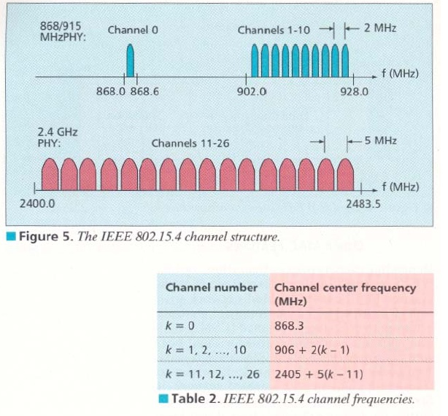
Channel structure

Slide 87
Channelization
27 frequency channels are available across all the 3 bands.
This standard includes the necessary things to implement dynamic channel selection to avoid interference.
The PHY layers contain several lower-level functions, such as receiver energy detection, link quality indication, and channel switching, which enable channel assessment.
These functions are used by the network to establish its initial operating channel and to change channels in response to a prolonged outage.

Slide 88
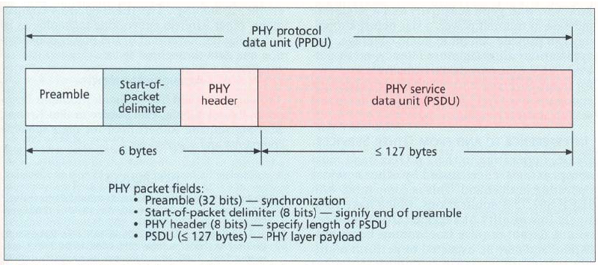
PHY layer packet structure

Slide 89
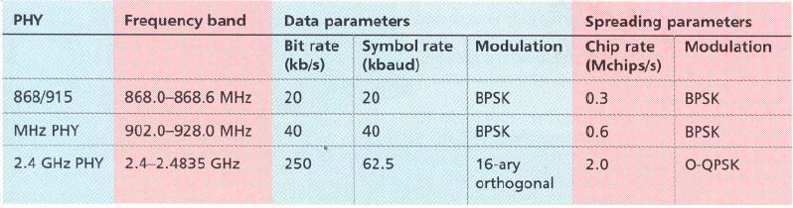
Modulation

Slide 90
Interference
Interference is common in 2.4 GHz band because of other services operating in that band
IEEE 802.15.4 applications have low QOS requirements and may need to perform multiple retries for packet transmissions on interference.
Since IEEE 802.15.4 devices may be sleeping as much as 99.9 percent of the time they are operational, and employ low-power spread spectrum transmissions, they should be among the best of neighbors in the 2.4 GHz band.

Slide 91
Bluetooth vs IEEE 802.15.4.
Bluetooth based WPAN
Few devices
Data range is 10m to 100m
Data rate is nearly 1Mb/s
Power consumption is a low.
Battery life is low.
Star only.
IEEE 802.15.4 LR-WPAN
Many devices
Data range is nearly 10m
Data rate is 20 kb/s,40kb/s,250kb/s.
Power consumption is ultra low.
Battery lasts years.
peer to peer,Star.

Slide 92
ZIGBEE alliance
The Zigbee Alliance is an association of companies involved with building higher-layer standards based on IEEE 802.15.4. This includes network, security, and application protocols.
A rapidly growing, worldwide, non-profit industry consortium consisting of Leading semiconductor manufacturers, Technology providers, End-users.
An Organization with a mission to define reliable, cost-effective, low-power, wirelessly networked, monitoring and control products based on an open global standard.
Now? Targeted at home and building automation and controls, consumer electronics, PC peripherals, medical monitoring, and toys

Slide 93
ZIGBEE alliance
Primary drivers are simplicity, long battery life, networking capabilities, reliability, and cost
Alliance provides interoperability, certification testing, and branding.
Six promoter companies – Honeywell, Invensys, Mitsubishi, Motorola, Samsung and Philips
A rapidly growing list (now almost 60 participants) of industry leaders worldwide committed to providing ZigBee-compliant products and solutions

Slide 94
ZIGBEE advantages
over proprietary solutions?
Product interoperability
Vendor independence
No more having to invest resources to create a new proprietary solution from scratch every time
Companies now can leverage these industry standards to instead focus their energies on finding and serving customers.

Slide 95
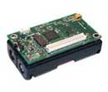
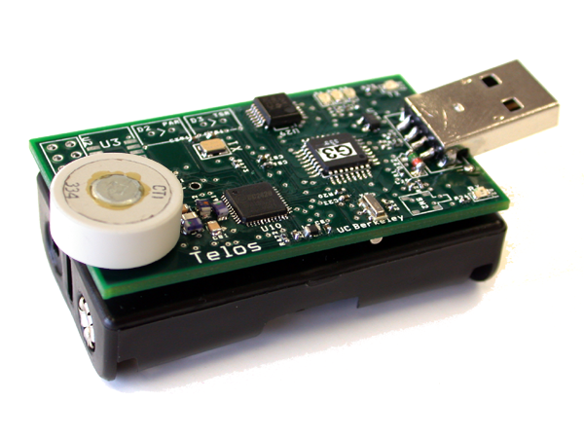
Micaz Telos
Telos module is programmed through the onboard USB connector.
New single board design with USB for ultra low power
Hardware link-layer encryption and authentication
Micaz follows mica line with 51 pin connector and compatibility with previous sensor boards and applications.
wireless Communications with Every Node as Router Capability

Slide 96
Micaz Telos
Small patch antenna connects through MMCX connector. MMCX connector allows for remote antenna.
Maintains compatibility with previous mote generations/sensors
Get 15.4 to people quickly to start work with it
Programming and data collection via USB
Fast wakeup from sleep.
Telos has two antenna options
New architecture = new low power mechanisms.
Telos leverages emerging wireless protocols and the open source software movement.
MicaZ (AVR)
0.2 ms wakeup
30 mW sleep
6 mW active
45 mW radio
250 kbps & 2.5V min
2/3 of AA capacity
Telos (TI MSP)
0.006 ms wakeup & 2 mW sleep
0.5 mW active & 45 mW radio
250 kbps & 1.6V min
7/8 of AA capacity
258 days
584 days
On a pair of AA batteries with a 1% duty cycle using TDMA or low power listening:
0.01 * (active current) + 0.99 * (sleep current) = avg current battery capacity / avg current = lifetime

Slide 97


Questions ?

